Slide 1
Business Intelligence
Lecture 3

Slide 2
Lecture Agenda
Decision Making in Business using Mathematical Roles
Introduction
Decision Tree
Naïve Bayes
Regressions: Logistic vs Linear
Clustering
Principal Components Analysis

Slide 3
The Role of Mathematical Models

Slide 4
Mathematical Models
Mathematics can be used to represent real-world situations.
The instruments used to represent real are called mathematical models.
They help us understand how the real-world works.
A simple mathematical model representing profit calculation is illustrated as
Revenues
Substract
Profit
Costs

Slide 5
Use of Mathematical Models in Business
Decision Making
Multiple participants with conflicting views
Use input variables and a set of conditions to arrive at a decision.
Decision-making problem faced by any business is the investment decision.
Decide whether to invest in a project or not

Slide 6
Use of Mathematical Models in Business
Making predictions
Requirement of predicting certain factors, such as revenue, growth rate, costs.
Used in case of new product launch, change in strategy, investment needs, etc.
Predictive mathematical models are used that analyze historical data and use probability distribution as input for predicting the future values.
Regression analysis

Slide 7
Use of Mathematical Models in Business
Optimizing
Include capacity planning, human resources planning, space planning, route planning.
Optimization mathematical models are typically used for such problems.
These models often maximize or minimize a quantity by making changes in another variable or a set of variables.

Slide 8
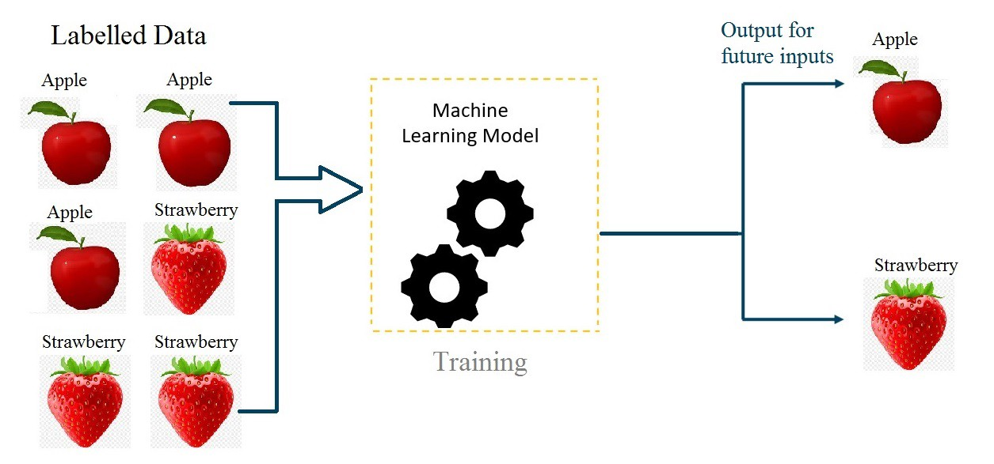

Supervised Learning
Given $N$ samples with $N$ labels, we want to predict a value for a new data row.

Slide 9
Decision Tree

Slide 10
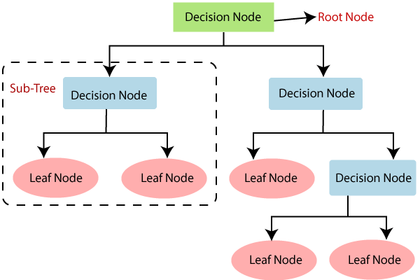
Decision Tree
A tree-like model that illustrates series of events leading to certain decisions
Each node represents a test on an attribute
Each branch is an outcome of that test
The leaves are the classified class

Slide 11
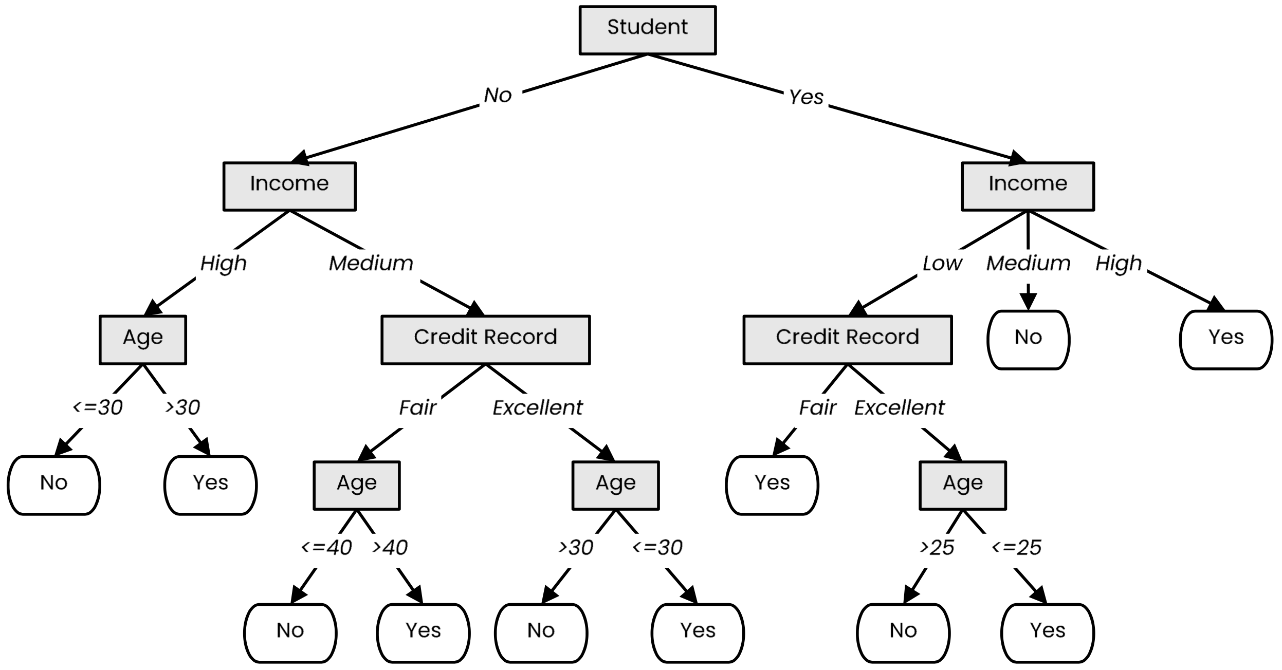
Decision Tree
Not a student
45 years old
Medium income
Fair credit record
Student
27 years old
Low income
Excellent credit record

Slide 12
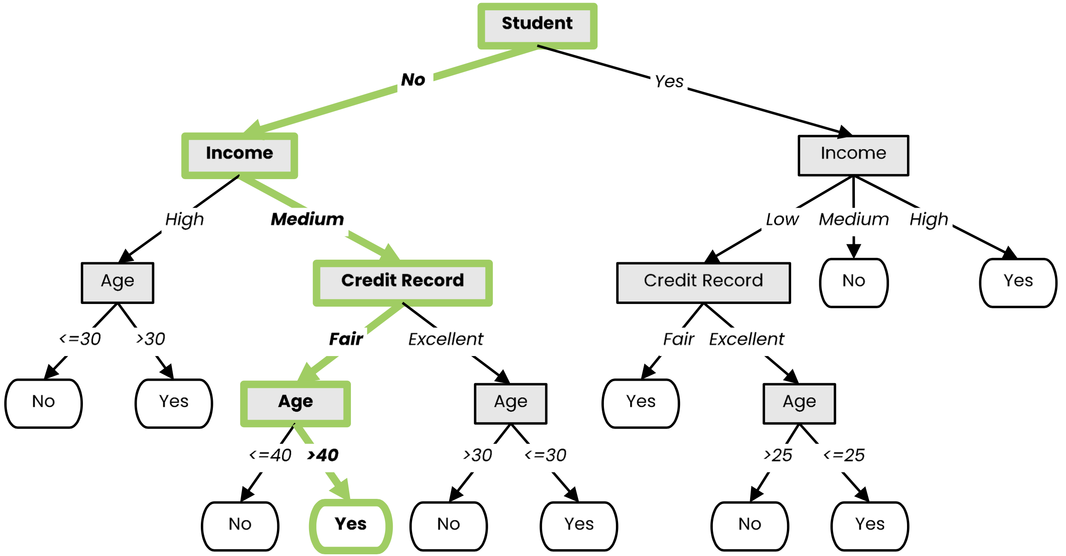
Decision Tree
Not a student
45 years old
Medium income
Fair credit record

Slide 13
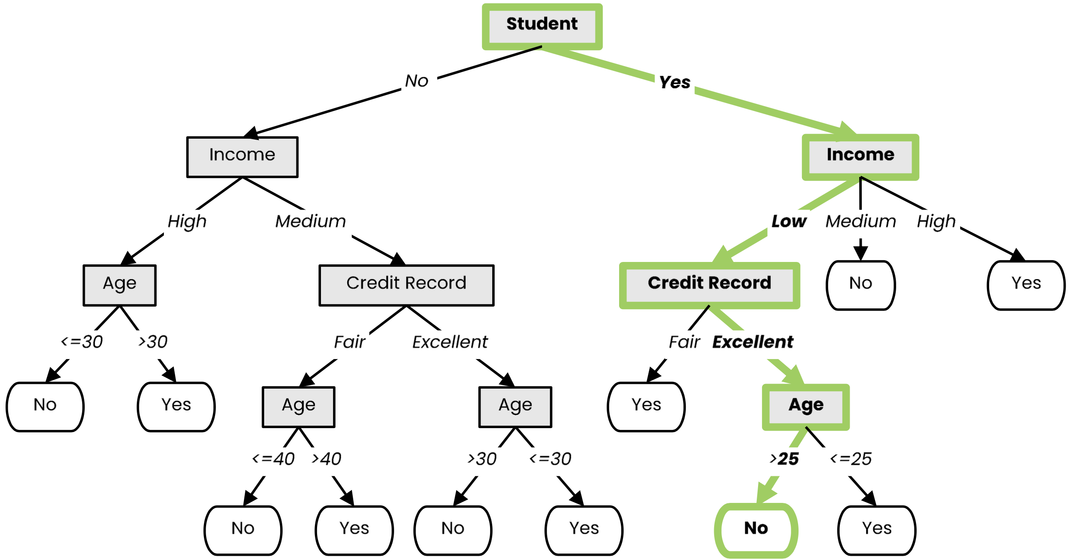
Decision Tree
Student
27 years old
Low income
Excellent credit record

Slide 14
History of Decision Trees
The first regression tree algorithm
“Automatic Interaction Detection (AID)” [Morgan & Sonquist, 1963]
The first classification tree algorithm
“Theta Automatic Interaction Detection (THAID)” [Messenger & Mandel, 1972]
Decision trees become popular
“Classification and regression trees (CART)” [Breiman et al., 1984]

Slide 15

Decision Tree Learning

Slide 16
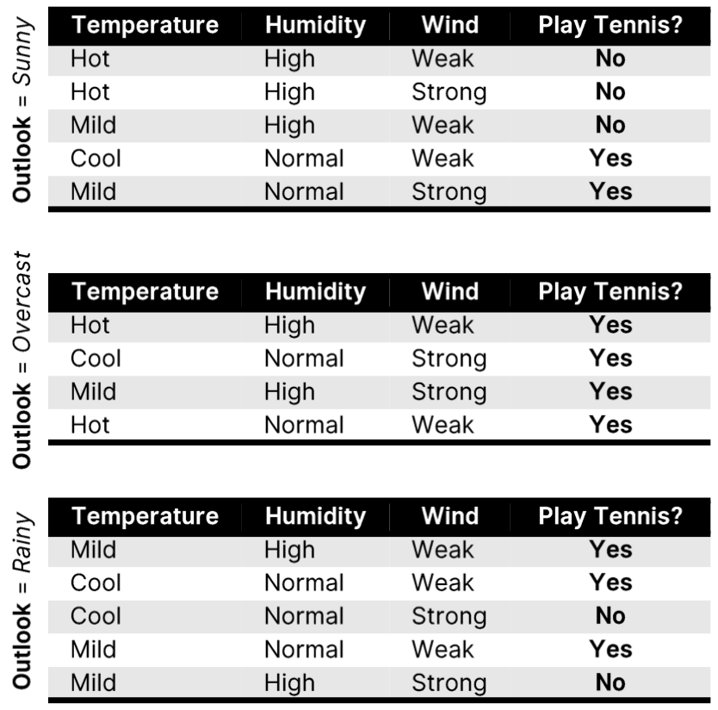
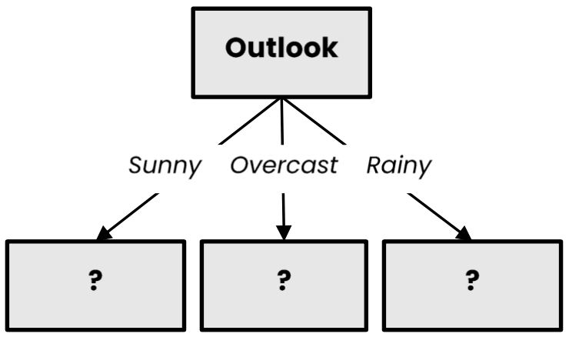
Decision Tree Learning
Choose an attribute and, based on its values, split the data into smaller sets. Recursively repeat this step until we can surely decide the label.

Slide 17
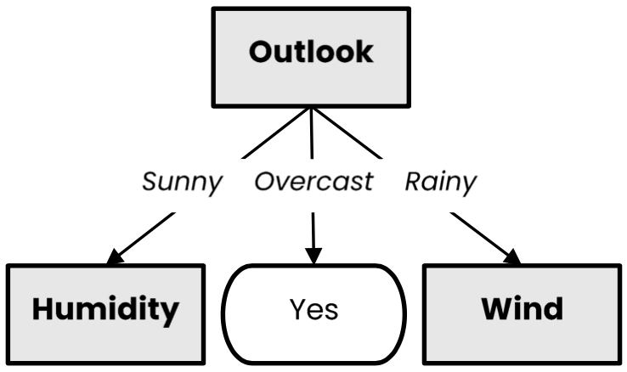
Decision Tree Learning

Slide 18
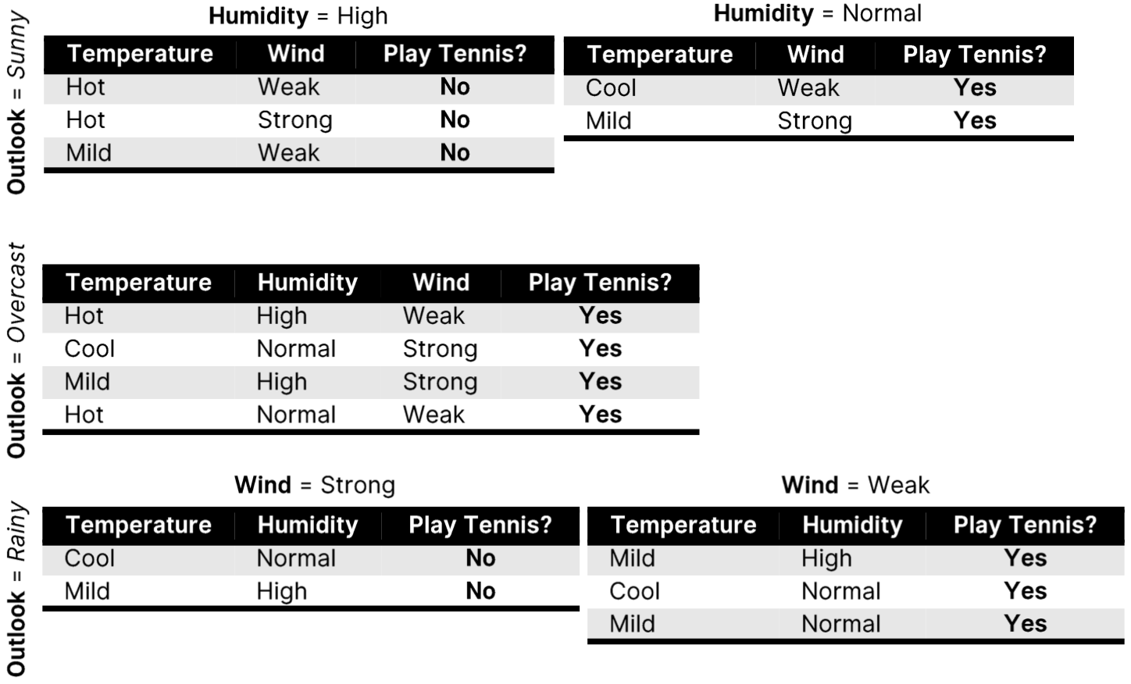
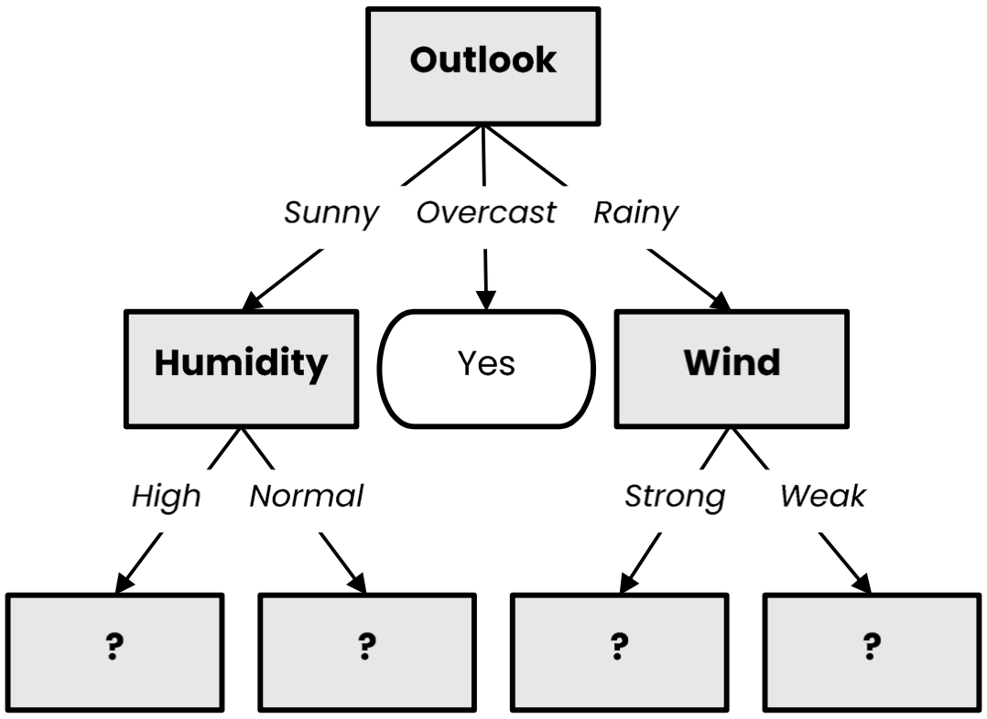
Decision Tree Learning

Slide 19
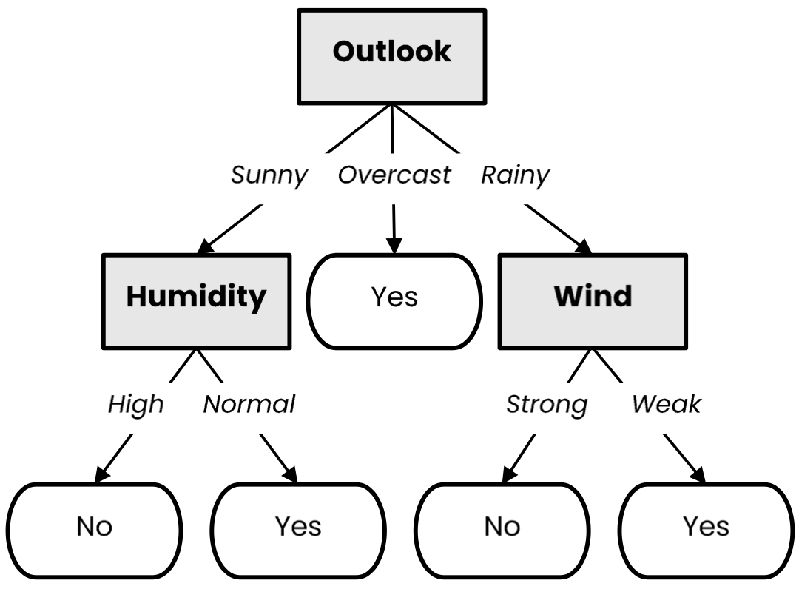
Decision Tree Learning

Slide 20


















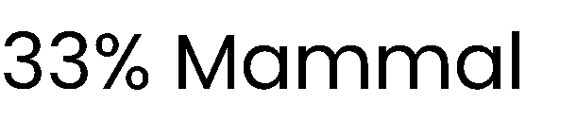

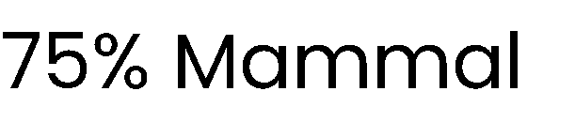
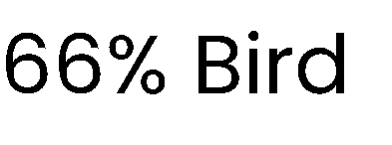
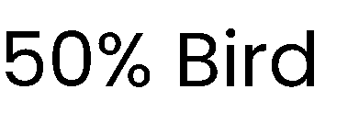

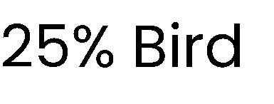
What is a good attribute?
Which attribute provides better splitting?
Resulting subsets are more pure
Knowing the value of this attribute gives us more information about the label
(the entropy of the subsets is lower)

Slide 21














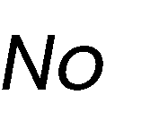

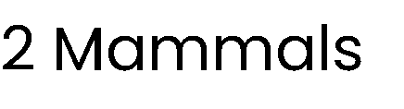
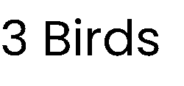
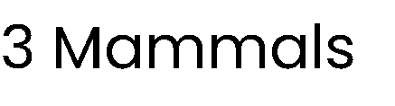
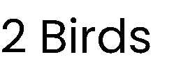

Best attribute = highest information gain
$$entropy \left(X\right)= − pmammal log2 pmammal−pbird log2 pbird=−\frac{3}{7} log2\frac{3}{7}−\frac{4}{7}log2\frac{4}{7}≈ 0.985$$

Slide 22



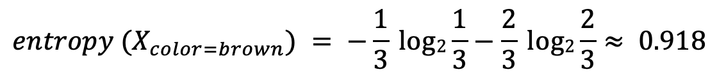
Best attribute = highest information gain
$$entropy \left(X\right)= − pmammal log2 pmammal−pbird log2 pbird=−\frac{3}{7} log2\frac{3}{7}−\frac{4}{7}log2\frac{4}{7}≈ 0.985$$
$$entropy (X_{color=brown}) = −\frac{1}{3} log2\frac{1}{3}−\frac{2}{3} log2\frac{2}{3}≈ 0.918$$

Slide 23

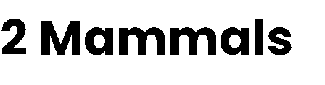

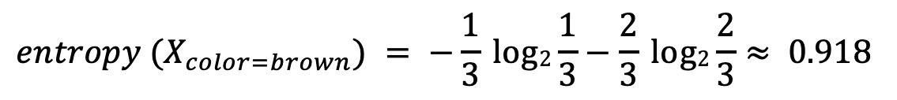
Best attribute = highest information gain
$$entropy \left(X\right)= − pmammal log2 pmammal−pbird log2 pbird=−\frac{3}{7} log2\frac{3}{7}−\frac{4}{7}log2\frac{4}{7}≈ 0.985$$
$$entropy (X_{color=brown}) = −\frac{1}{3} log2\frac{1}{3}−\frac{2}{3} log2\frac{2}{3}≈ 0.918$$
$$entropy (X_{color=white}) =1$$

Slide 24
Best attribute = highest information gain
$$entropy \left(X\right)= − pmammal log2 pmammal−pbird log2 pbird=−\frac{3}{7} log2\frac{3}{7}−\frac{4}{7}log2\frac{4}{7}≈ 0.985$$
$$entropy (X_{color=brown}) = −\frac{1}{3} log2\frac{1}{3}−\frac{2}{3} log2\frac{2}{3}≈ 0.918$$
$$entropy (X_{color=white}) =1$$
$$gain \left(X, color\right)=0.985−\frac{3}{7}∙0.918−\frac{4}{7}∙1≈0.020$$

Slide 25



Best attribute = highest information gain
$$entropy \left(X\right)= − pmammal log2 pmammal−pbird log2 pbird=−\frac{3}{7} log2\frac{3}{7}−\frac{4}{7}log2\frac{4}{7}≈ 0.985$$
$$entropy (X_{color=brown}) = −\frac{1}{3} log2\frac{1}{3}−\frac{2}{3} log2\frac{2}{3}≈ 0.918$$
$$entropy (X_{color=white}) =1$$
$$gain \left(X, color\right)=0.985−\frac{3}{7}∙0.918−\frac{4}{7}∙1≈0.020$$
$$entropy (X_{fly=yes}) =0$$

Slide 26



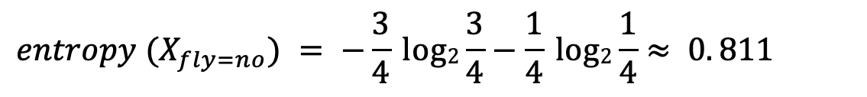
Best attribute = highest information gain
$$entropy \left(X\right)= − pmammal log2 pmammal−pbird log2 pbird=−\frac{3}{7} log2\frac{3}{7}−\frac{4}{7}log2\frac{4}{7}≈ 0.985$$
$$entropy (X_{color=brown}) = −\frac{1}{3} log2\frac{1}{3}−\frac{2}{3} log2\frac{2}{3}≈ 0.918$$
$$entropy (X_{color=white}) =1$$
$$gain \left(X, color\right)=0.985−\frac{3}{7}∙0.918−\frac{4}{7}∙1≈0.020$$
$$entropy (X_{fly=no}) = −\frac{3}{4} log2\frac{3}{4}−\frac{1}{4} log2\frac{1}{4}≈ 0. 811$$
$$entropy (X_{fly=yes}) =0$$

Slide 27
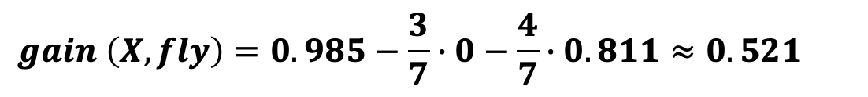
Best attribute = highest information gain
$$entropy \left(X\right)= − pmammal log2 pmammal−pbird log2 pbird=−\frac{3}{7} log2\frac{3}{7}−\frac{4}{7}log2\frac{4}{7}≈ 0.985$$
$$entropy (X_{color=brown}) = −\frac{1}{3} log2\frac{1}{3}−\frac{2}{3} log2\frac{2}{3}≈ 0.918$$
$$entropy (X_{color=white}) =1$$
$$gain \left(X, color\right)=0.985−\frac{3}{7}∙0.918−\frac{4}{7}∙1≈0.020$$
$$entropy (X_{fly=no}) = −\frac{3}{4} log2\frac{3}{4}−\frac{1}{4} log2\frac{1}{4}≈ 0. 811$$
$$entropy (X_{fly=yes}) =0$$
$$gain \left(X, fly\right)=0.985−\frac{3}{7}∙0−\frac{4}{7}∙0.811≈0.521$$

Slide 28
Handling Numerical Attributes

Slide 29





















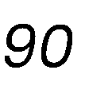
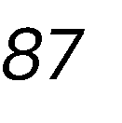
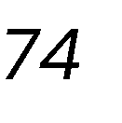
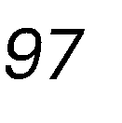









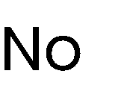








Handling numerical attributes
Consider a numerical value for humidity

Slide 30

























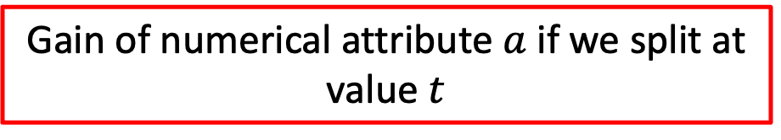
Handling numerical attributes
Gain of numerical attribute $a$ if we split at value $t$
$$gain\left(X, a, t\right)= entropy\left(X\right)−\frac{\left|X_{a≤t}\right|}{\left|X\right|}entropy\left(X_{a≤t}\right)−\frac{\left|X_{a>t}\right|}{\left|X\right|}entropy\left(X_{a>t}\right)$$
Mean of each consecutive pair
Sort

Slide 31
Handling numerical attributes
$$gain\left(X, a, t\right)= entropy\left(X\right)−\frac{\left|X_{a≤t}\right|}{\left|X\right|}entropy\left(X_{a≤t}\right)−\frac{\left|X_{a>t}\right|}{\left|X\right|}entropy\left(X_{a>t}\right)$$
Mean of each consecutive pair
Sort
$$gain \left(X, humidity, 83.5\right)=$$

Slide 32
Handling numerical attributes
$$gain\left(X, a, t\right)= entropy\left(X\right)−\frac{\left|X_{a≤t}\right|}{\left|X\right|}entropy\left(X_{a≤t}\right)−\frac{\left|X_{a>t}\right|}{\left|X\right|}entropy\left(X_{a>t}\right)$$
Mean of each consecutive pair
Sort
$$gain \left(X, humidity, 83.5\right)=0.94$$

Slide 33

Handling numerical attributes
$$gain\left(X, a, t\right)= entropy\left(X\right)−\frac{\left|X_{a≤t}\right|}{\left|X\right|}entropy\left(X_{a≤t}\right)−\frac{\left|X_{a>t}\right|}{\left|X\right|}entropy\left(X_{a>t}\right)$$
Mean of each consecutive pair
Sort
$$gain \left(X, humidity, 83.5\right)=0.94−\frac{7}{14}∙0.59$$

Slide 34

Handling numerical attributes
$$gain\left(X, a, t\right)= entropy\left(X\right)−\frac{\left|X_{a≤t}\right|}{\left|X\right|}entropy\left(X_{a≤t}\right)−\frac{\left|X_{a>t}\right|}{\left|X\right|}entropy\left(X_{a>t}\right)$$
Mean of each consecutive pair
Sort
$$gain \left(X, humidity, 83.5\right)=0.94−\frac{7}{14}∙0.59−\frac{7}{14}∙0.98$$

Slide 35
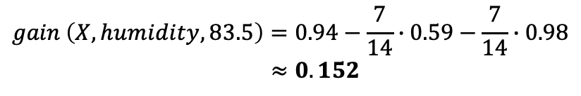
Handling numerical attributes
$$gain\left(X, a, t\right)= entropy\left(X\right)−\frac{\left|X_{a≤t}\right|}{\left|X\right|}entropy\left(X_{a≤t}\right)−\frac{\left|X_{a>t}\right|}{\left|X\right|}entropy\left(X_{a>t}\right)$$
Mean of each consecutive pair
Sort
$$gain \left(X, humidity, 83.5\right)=0.94−\frac{7}{14}∙0.59−\frac{7}{14}∙0.98$$
$$≈0.152$$

Slide 36















Handling numerical attributes
83.5 is the best splitting value with an information gain of 0.152
Mean of each consecutive pair
Gain for every candidate
Sort

Slide 37









Handling numerical attributes
Numerical attributes have to be treated differently
Find the best splitting value
83.5 is the best splitting value for Humidity with an information gain of 0.152
Humidity is now treated as a categorical attribute with two possible values
A new optimal split is computed at every level of the tree
A numerical attribute can be used several times in the tree, with different split values
 |  | >
 |  | >
 |  | >
 |  | >
 |  | ≤
 |  | ≤
 |  | ≤
 |  | >
 |  | ≤
 |  | ≤
 |  | ≤
 |  | >
 |  | ≤
 |  | >

Slide 38
Random Forests
(Ensemble learning with decision trees)

Slide 39
Random Forests
Random Forests:
Instead of building a single decision tree and use it to make predictions, build many slightly different trees and combine their predictions
We have a single data set, so how do we obtain slightly different trees?
1. Bagging (Bootstrap Aggregating):
Take random subsets of data points from the training set to create N smaller data sets
Fit a decision tree on each subset
2. Random Subspace Method (also known as Feature Bagging):
Fit N different decision trees by constraining each one to operate on a random subset of features

Slide 40









Bagging at training time
N subsets (with replacement)
Training set

Slide 41









Bagging at inference time
A test sample
75% confidence

Slide 42
Naïve Bayes

Slide 43
Naïve Bayes Classifier
Naive Bayes is a statistical classification technique based on Bayes Theorem. It is one of the simplest supervised learning algorithms.
Naive Bayes classifier is the fast, accurate and reliable algorithm.
Naive Bayes classifiers have high accuracy and speed on large datasets.
Assumes that the effect of a particular feature in a class is independent of other features.
Disadvantage: bad for dummy variables ☹

Slide 44
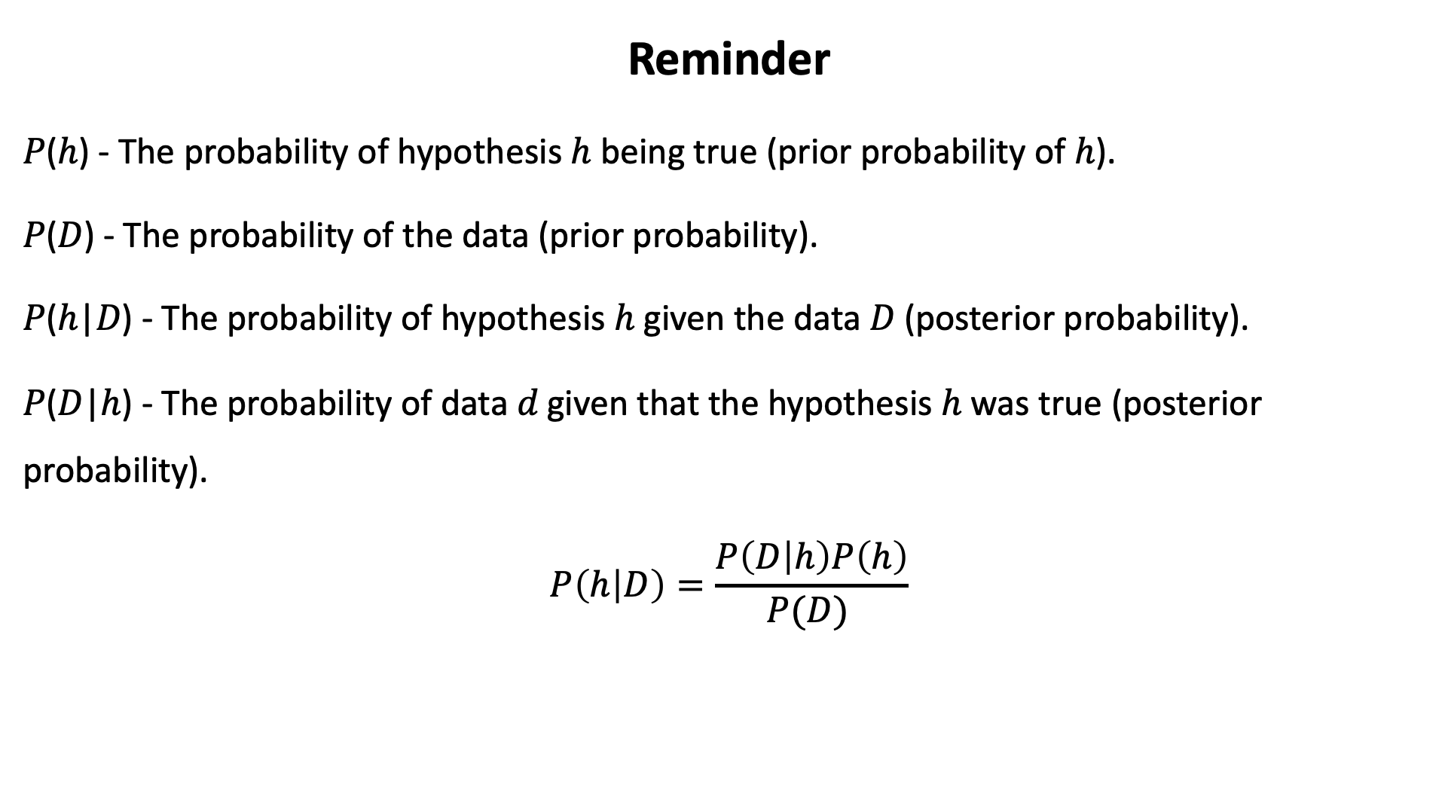
Reminder
𝑃(ℎ) - The probability of hypothesis ℎ being true (prior probability of ℎ).
𝑃(𝐷) - The probability of the data (prior probability).
𝑃(ℎ|𝐷) - The probability of hypothesis ℎ given the data 𝐷 (posterior probability).
𝑃(𝐷|ℎ) - The probability of data 𝑑 given that the hypothesis ℎ was true (posterior probability).
$$P\left(h | D\right)=\frac{P\left(D | h\right)P\left(h\right)}{P(D) }$$

Slide 45
How it Works?
Step 1: Calculate the prior probability for given class labels.
Step 2: Find Likelihood probability with each attribute for each class.
Step 3: Put these value in Bayes Formula and calculate posterior probability.
Step 4: See which class has a higher probability, given the input belongs to the higher probability class.

Slide 46
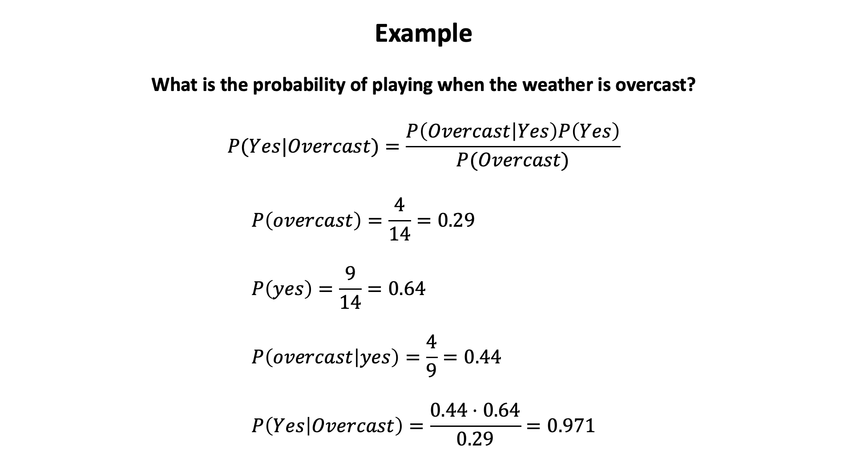
Example
What is the probability of playing when the weather is overcast? $$P(Yes|Overcast)=\frac{P\left(Overcast | Yes\right)P\left(Yes\right)}{P(Overcast)}$$
$$P\left(overcast\right)=\frac{4}{14}=0.29 \\ P\left(yes\right)=\frac{9}{14}=0.64 \\ P\left(overcast | yes\right)=\frac{4}{9}=0.44 \\ P\left(Yes | Overcast\right)=\frac{0.44⋅0.64}{0.29}=0.971$$
weather | temp | play
Sunny | Hot | No
Sunny | Hot | No
Overcast | Hot | Yes
Rainy | Mild | Yes
Rainy | Cool | Yes
Rainy | Cool | No
Overcast | Cool | Yes
Sunny | Mild | No
Sunny | Cool | Yes
Rainy | Mild | Yes
Sunny | Mild | Yes
Overcast | Mild | Yes
Overcast | Hot | Yes
Rainy | Mild | No

Slide 47
Regressions

Slide 48
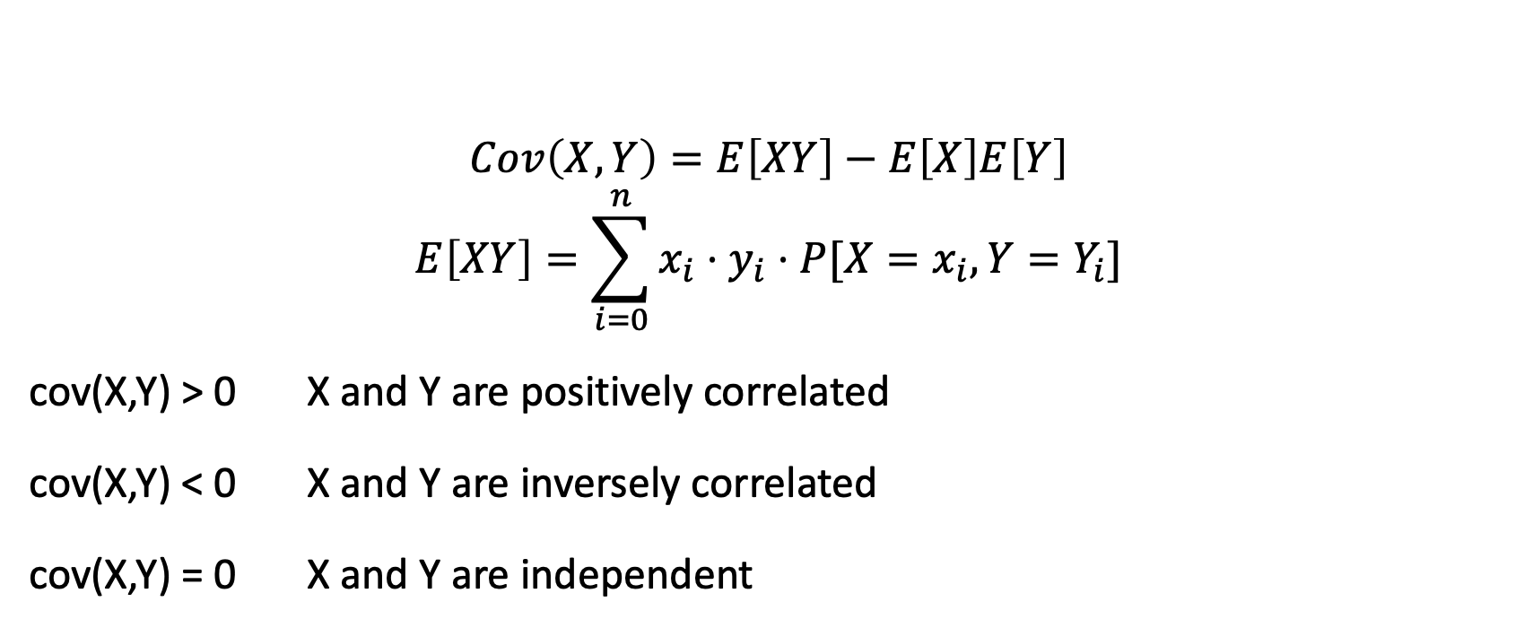
Recall: Covariance
$$Cov\left(X,Y\right)=E\left[XY\right]−E\left[X\right]E\left[Y\right]$$
$$E\left[XY\right]=\sum_{i=0}^{n}{x_{i}⋅y_{i}⋅P[X=x_{i},Y=Y_{i}]}$$
cov(X,Y) > 0 X and Y are positively correlated
cov(X,Y) < 0 X and Y are inversely correlated
cov(X,Y) = 0 X and Y are independent

Slide 49
Correlation coefficient
$$ρ=\frac{Cov(X,Y)}{σ_{x}σ_{y}}$$
Measures the relative strength of the linear relationship between two variables
Ranges between –1 and 1
The closer to –1, the stronger the negative linear relationship
The closer to 1, the stronger the positive linear relationship
The closer to 0, the weaker any positive linear relationship

Slide 50
Scatter Plots of Data with Various Correlation Coefficients
Y
Y
Y
X
X
X
r = -1
r = -.6
r = 0
Y
Y
Y
X
X
X
r = +1
r = +.3
r = 0
Slide from: Statistics for Managers Using Microsoft® Excel 4th Edition, 2004 Prentice-Hall

Slide 51
Linear Correlation
Linear relationships
Curvilinear relationships
Y
Y
X
X
Y
Y
X
X
Slide from: Statistics for Managers Using Microsoft® Excel 4th Edition, 2004 Prentice-Hall

Slide 52
Linear Correlation
Strong relationships
Weak relationships
Y
Y
X
X
Y
Y
X
X
Slide from: Statistics for Managers Using Microsoft® Excel 4th Edition, 2004 Prentice-Hall

Slide 53
Linear Correlation
No relationship
Y
X
Y
X
Slide from: Statistics for Managers Using Microsoft® Excel 4th Edition, 2004 Prentice-Hall

Slide 54
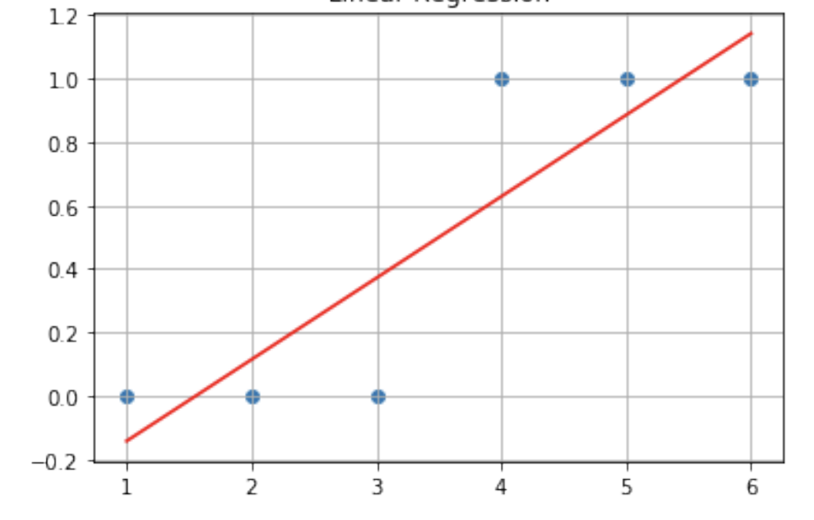
Logistic Regression
Logistic Regression is a simple adaptation of Linear Regression with the assumption that the dependent variable is categorical and has only two values.
Linear regression gives you a continuous output, but logistic regression provides a constant output. How can we do it?

Slide 55
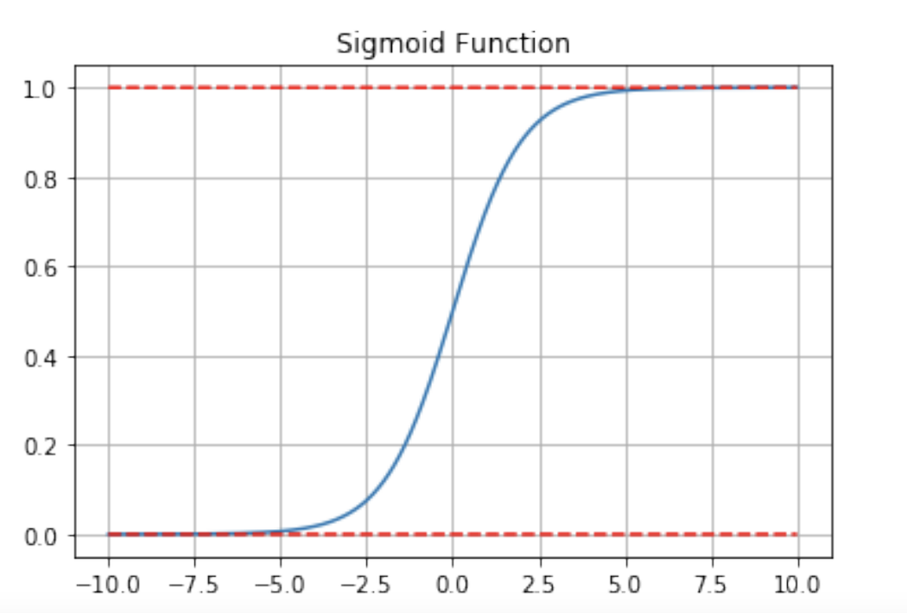
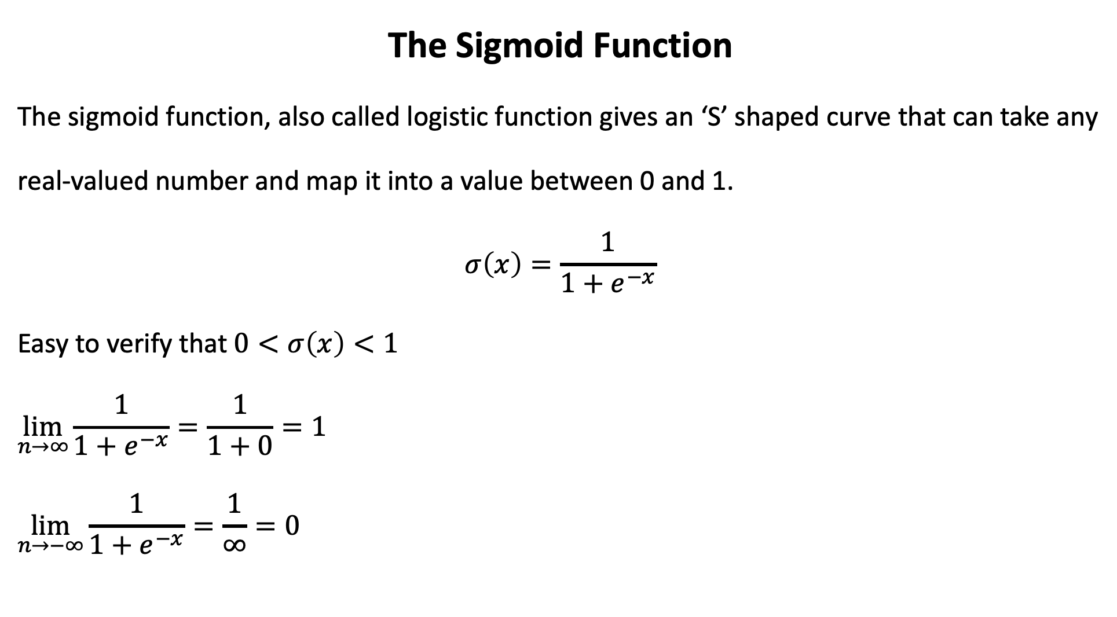
The Sigmoid Function
The sigmoid function, also called logistic function gives an ‘S’ shaped curve that can take any
real-valued number and map it into a value between 0 and 1.
$$σ\left(x\right)=\frac{1}{1+e^{−x}}$$
Easy to verify that $0<σ\left(x\right)<1$ $$\lim_{n→∞}{\frac{1}{1+e^{−x}}}=\frac{1}{1+0}=1 \\ \lim_{n→−∞}{\frac{1}{1+e^{−x}}}=\frac{1}{∞}=0$$

Slide 56
Logistic Regression
Benefits of sigmoid:
Bound between 0 to 1
Can describe the probability of prediction
Fit “linear” into “logistic”

Slide 57
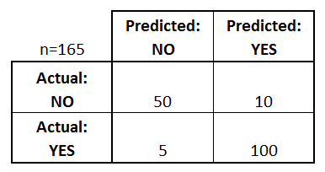
Performance
A confusion matrix is a table that is often used to describe the performance of a classification model (or “classifier”) on a set of test data for which the true values are known. Let us look at some of the important terms of confusion matrix.

Slide 58
Performance
Basic terms related to Confusion matrix:
True positives (TP): predict TRUE, actual TRUE
True negatives (TN): predict FALSE, actual FALSE
False positives (FP): predict TRUE, actual FALSE
False negatives (FN): predict FALSE, actual TRUE

